Slide 1
Theory of Inference
Prepared by
Mogana N

Slide 2
Theory of Inference
Functions of Logic:
Provide rule of inference
Principle of reasoning
Inference Theory:
The theory associated with such rules is called as Inference Theory because It is concerned with the inferring of a conclusion from certain premises.
Deduction of Formal Proof:
When a conclusion is drawn using the set of premises using rules of inference is called deduction of formal proof.
Difference between reasoning used in general discussion and mathematics are premises are believed to be true based on faith or experience while in mathematics one is solely concerned with the rules of logic.
The conclusion is called a theorem can be inferred from the set of premises called axioms. The truth value plays no role in this.

Slide 3
Argument
If A and B are two statements then, we say that “B logically follows from A” or “B is a valid conclusion” of the premise A, iff
A-> B is a tautology, ie., A=>B
This definition can be extended for a set of formulas rather than a single formula, we say that from a set of premises { H1, H 2, ….. Hm }
A conclusion C follows logically iff
H1 Λ H2 ΛH3 Λ ….. Hm => C ......... (1)
Representation: H1
H2
………. Hn
------------------
therefore, C

Slide 4
Argument
An argument is a sequence of statements. The last statement is the conclusion and all its preceding statements are called premises (or hypothesis).
The symbol “∴”, (read therefore) is placed before the conclusion. A valid argument is one where the conclusion follows from the truth values of the premises.
Example 1: Valid argument
p1: If it rains, I will not go for shopping
p2: It is raining
---------------------------------------------------
∴ I will not go for shopping
----------------------------------------------------
Example 2: Invalid argument
p1: If it rains, I will not go for shopping
p2: It is raining
---------------------------------------------------
∴ I will go for shopping
----------------------------------------------------
Example 3: Valid argument
p1: If it rains, I will not go for shopping
p2: It is not raining
---------------------------------------------------
∴ I am going for shopping
----------------------------------------------------

Slide 5
Validity from Truth Table
Given a set of premises and a conclusion , it is possible to determine whether the conclusion logically follows from the given premises by constructing truth tables as follows:
Let P1, P2……. Pn, be all the variables appearing in the premises H1, H 2……. Hm and the conclusion C.
If all possible combinations of the truth values are assigned to P1, P2, … Pn and if the truth values of H1, H2, …Hm, and C are entered in a table, then it is easy to see from such a table whether (1) is true.
We look for the rows in which all H1, H 2……. Hm have the value T. If ,for every such row, C also has the value T, then(1) holds.
Alternatively, we may look for the rows in which C has the value F. If, in every such row , at least one of the values of H1, H 2……. Hm is F, then (1) holds.
We call such a method a “ truth table technique” for determination of the validity of a conclusion

Slide 6
IIIUSTRATION EXAMPLE
1. Determine whether the conclusion C follows logically from the premises H1 and H2 .
(a) H1 :P->Q H2 : P C : Q
(b) H1 :P->Q H2 : ~P C: Q
(c) H1 :P->Q H2 :~(P ΛQ) C : ~P
(d) H1 :~P H2 : P ↔Q C:~(P Λ Q)
(e) H1 : P->Q H2 : Q C: P

Slide 7
Truth Table
P | Q | P->Q | ~P | ~Q | ~(P ΛQ) | P ↔Q
F | F | T | T | T | T | T
F | T | T | T | F | T | F
T | F | F | F | T | T | F
T | T | T | F | F | F | T

Slide 8
Rules of inference
RoI are criteria for determining validity of an argument.
Simple arguments can be used as building blocks to construct more complicated valid arguments.
Certain simple arguments that have been established as valid are very important in terms of their usage. These arguments are called Rules of Inference. The most commonly used Rules of Inference are explained in following slides.
Rules of Inference provide the templates or guidelines for constructing valid arguments from the statements that we already have

Slide 9
1. Addition
If P is a premise, we can use Addition rule to derive P∨Q.
P
---------
∴P∨Q
Example
Let P be the proposition, “He studies very hard” is true
Therefore − "Either he studies very hard Or he is a very lazy student."
Q is the proposition “he is a very lazy student”.

Slide 10
2. Conjunction
If P and Q are two premises, we can use Conjunction rule to derive P∧Q.
P
Q
----------
∴P∧Q
Example
Let P − “He studies very hard”
Let Q − “He is the sincere boy in the class”
Therefore − "He studies very hard and he is the sincere boy in the class"

Slide 11
3. Simplification
If P∧Q is a premise, we can use Simplification rule to derive P.
P∧Q
----------------
∴P
Example
"He studies very hard and he is the sincere in the class", P∧Q
Therefore − "He studies very hard” P

Slide 12
4. Modus Ponen
If P and P→Q are two premises, we can use Modus Ponens to derive Q.
P→Q
P
-------
∴Q
-------
Example
"If you have a password, then you can log on to facebook", P→Q
"You have a password", P
Therefore − "You can log on to facebook"

Slide 13
5. Modul Tollens
If P→Q and ¬Q are two premises, we can use Modus Tollens to derive ¬P.
P→Q
¬Q
-------
∴¬P
Example
"If you have a password, then you can log on to facebook", P→Q
"You cannot log on to facebook", ¬Q
Therefore − "You do not have a password "

Slide 14
6. Disjunctive Syllogism
If ¬P and P∨Q are two premises, we can use Disjunctive Syllogism to derive Q.
¬P
P∨Q
-------
∴Q
Example
"The ice cream is not vanilla flavored", ¬P
"The ice cream is either vanilla flavored or chocolate flavored", P∨Q
Therefore − "The ice cream is chocolate flavored”

Slide 15
7. Hypothetical Syllogism
If P→Q and Q→R are two premises, we can use Hypothetical Syllogism to derive P→R
P→Q
Q→R
-------
∴P→R
Example
"If it rains, I shall not go to school”, P→Q
"If I don't go to school, I won't need to do homework", Q→R
Therefore − "If it rains, I won't need to do homework

Slide 16
8. Constructive Dilemma
If (P→Q)∧(R→S) and P∨R are two premises, we can use constructive dilemma to derive Q∨S.
(P→Q)∧(R→S)
P∨R
-------------------
∴Q∨S
Example
“If it rains, I will take a leave”, (P→Q)
“If it is pleasant outside, I will go for a ride”, (R→S)
“Either it will rain or it is pleasant outside”, P∨R
Therefore − "I will take a leave or I will go for a ride"

Slide 17
9. Destructive Dilemma
If (P→Q)∧(R→S) and ¬Q∨¬S are two premises, we can use destructive dilemma to derive ¬P∨¬R.
(P→Q)∧(R→S)
¬Q∨¬S
------------------
∴¬P∨¬R
Example
“If it rains, I will take a leave”, (P→Q)
“If it is pleasant outside, I will go for a ride”, (R→S)
“Either I will not take a leave or I will not go for a ride”, ¬Q∨¬S
Therefore − "Either it does not rain or it is not pleasant outside"

Slide 18
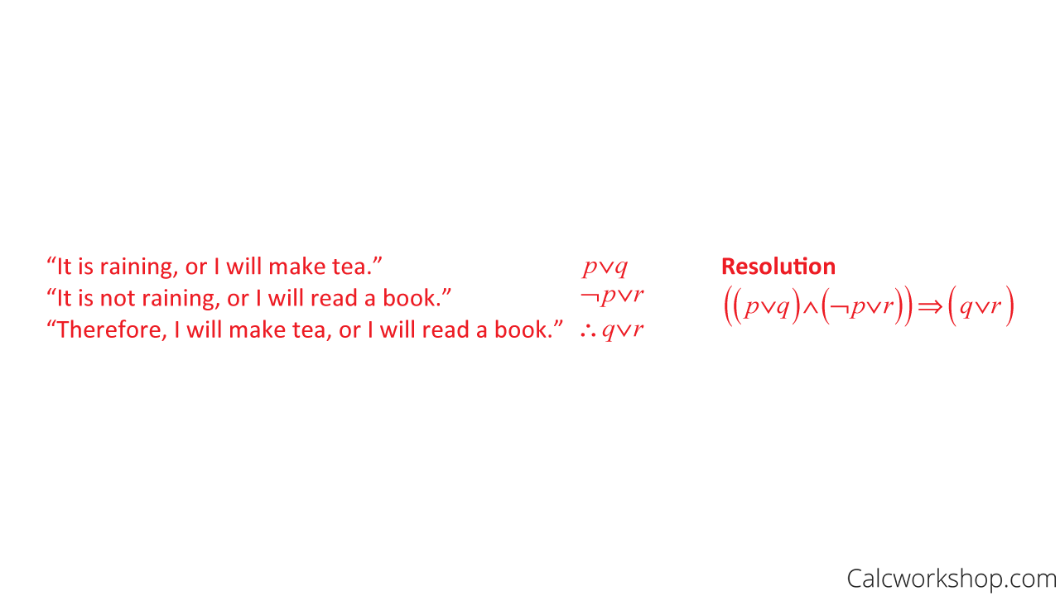
10. Resolution

Slide 19
Example Problem for Rules of Inference
Test the validity of the following argument:
If it snows, Paul will miss class.
Paul did not miss class.
Therefore, it did not snow.
Steps:
translate the argument into symbolic form
then determine if it matches one of the rules of inference.

Slide 20
Solution
If it snows, Paul will miss class : p->q
Paul did not miss class. : ¬q
Therefore, it did not snow : ¬p
It matches modus tollens rules of inference. Hence it is valid.
P→Q
¬Q
-------
∴¬P

Slide 21
Predicate Logic
The logic based upon the analysis of predicates in any statement is called predicate logic.
Example:
John is a bachelor …………………………………..(1)
Smith is a bachelor…………………………………...(2)
Predicate: The part of the statement which describes the subject is called predicate. In the above statements John and Smith are subjects. ‘is a bachelor’ is predicate
Notations used:
Predicate is indicated by capital letters
Subject is indicated by small letters
So, if John is represented as j and Smith by s, the predicate ‘ is a bachelor’ by B, then, the statement (1) and (2) are written as B(j) and B(s) respectively.

Slide 22
Predicate
In general, any statement of the type “ p is Q” where Q is a predicate and p is the subject can be denoted by Q(p).
Prepositions can be combined with predicates to form complex expressions.
Eg: This painting is red. ………………………………..(3)
If ‘painting’ is represented as p, ‘is red’ is represented as R then statement (3) can be written as R(p).
Eg: John is a bachelor and this painting is red…….(4)
can be written as B(j) Λ R(p) .
Eg: Other representations
~ R(p) , B(j) -> R(p) etc

Slide 23
M-place Predicate
A predicate requiring m( where m>0) names or object is called an m-place predicate.
Example:
Amul is a student
The predicate S : is a student is a 1-place predicate because it is related to one object Amul
Naveen is taller than Amal
The predicate T : “is taller than “ is a 2-place predicate .[ T(a,b)]
(3) 2-place predicate : Canada is to the north of the United states
If the predicate N : “is to the north of,” c: Canada , and s: United States , the statement can be symbolized as N(c,s).
3-place predicates : Susan sits between Ralph and Bill.
4-place predicates : Green and Miller played badminton against Johnston and Smith .

Slide 24
Generalization of m-place predicate
If a1 , a2 ,........,a n are the names of objects, and S is a predicate
then S( a1 , a2 ,........,a n ) are n-place predicate.
If we write S(x) for “ x is a student”, then S(a) , S(b) , S(c) and others having the same form can be obtained from S(x), by replacing x by an appropriate name.
Hence x is a place holder.
Compound statement functions can be formed by combining one or more simple statement functions and logical connectives.
If x has a constraint that it can take only set of values or class of values then the all possible values that x can take is called “Universe of Discourse”

Slide 25
Quantifiers
Lets take this example:
1. All man are mortal.
2. Every apple is red.
3. Any integer is either positive or negative
Let us paraphrase these in the following manner.
1a. For all x , if x is a man, then x is a mortal.
2a. For all x , if x is an apple, then x is red.
3a. For all x , if x is an integer , then x is either positive or negative.

Slide 26
Quantifier- definition
Quantifier is used to quantify the variable of predicates.
It contains a formula, which is a type of statement whose truth value may depend on values of some variables.
When we assign a fixed value to a predicate, then it becomes a proposition.
So quantify is a type of word which refers to quantifies like "all" or "some".
There are mainly two types of quantifiers that are universal quantifiers and existential quantifiers.
Quantifier is mainly used to show that for how many elements, a described predicate is true. It also shows that for all possible values or for some value(s) in the universe of discourse, the predicate is true or not.

Slide 27
Quantifier - Example
Example :Let p: "x ≤ 5 ∧ x > 3“
Is p true or false? { Can not be inferred as x value is not given}
Is p true or false, if x=6 { false}
Is p true or false, if x=4 { true }
For every x, x ≤ 5 ∧ x > 3, is p true or false? {false, universal quantifier}
There exists an x such that "x ≤ 5 ∧ x > 3“ {true, existential quantifier}
The variables in a formula cannot be simply true or false unless we bound these variables by using the quantifier

Slide 28
Types of Quantifier
Universal Quantifier
Existential Quantifier

Slide 29
Universal Quantifier
Universal quantifier means – “ for all”
It means the predicate is true for all values of the variables in its domain. (domain of discourse)
It uses the symbol ∀, which means "for all“
It is placed before the statement function to which this phrase is applied.
Example- ∀x P(x) or ∀x є D , P(x)
The universal quantifier is used to translate expressions such as “for all,” “ every “ , and “for any “.

Slide 30
Example
Example:
M(x) : x is man
H(x) : x is a mortal
A(x) : x is an apple
R(x) : x is red.
N(x) : x is an integer.
P(x) : x is either positive or negative.
Represent “all men are mortal”
∀x (M(x)->H(x)
Represent “ all integers are either positive or negative”
∀x (N(x)->P(x)

Slide 31
G(x,y) : x is taller than y.
Represent: For any x and any y , if x is taller than y, than y is not taller than x” or “ For any x and y , if x is taller than y, then it is not true that y is taller than x.”
This statement can now be symbolized as (∀ x ) (∀ y ) ( G(x,y)->~ G(y,x))

Slide 32
2. Existential Quantifier
It symbolize expressions such as “ for some” , “there is at least one” or “ there exists some”
The existential quantifier symbol is denoted by the ∃, which means "there exists“
The sentence ∃xP(x) will be true if and only if P(x) is true for at least one x in D. The statement ∃xP(x) will be false if and only if P(x) is false for all x in D.

Slide 33
Example
M(x) : x is a man.
C(x) : x is clever
(∃ x ) ( M(x))
(∃ x ) (M(x) ΛC(x))

